Slide 1
NATIONAL COMPASSIONATE, RESPECTFUL AND CARING TRAINING
Chapter Four: Principles and standards of compassionate care

Slide 2
Outline
Compassion in care
Elements of compassionate care
Principles of compassionate care
Threats of compassionate care
Guided clinical practice

Slide 3
Session one
Compassion in care

Slide 4
Introduction
Can compassion be trained and learned?
Time Allowed: 10 Minutes

Slide 5
Session Objective
At the end of this session, participants will be able to:
Define compassionate care
Identify the characteristics and qualities of compassionate care

Slide 6

Introduction …
Compassion can be defined as
‘a sensitivity to the suffering of self and others with a deep wish and commitment to relieve the suffering’.

Slide 7
Characteristic and qualities of compassion…
Motivation
The initial stage requires the motivation to be caring, supportive and helpful to others.
This is the “ commitment to try to do something about it” aspects of compassion.

Slide 8
Characteristic and qualities of compassion…
Being sensitive
This is the capacity to be sensitive and to maintain open attention, enabling us to notice when others need help.

Slide 9
Characteristic and qualities of compassion…
Sympathetic
Compassion requires us to be emotionally open to ours and others’ suffering.
This means that we are emotionally touched, moved and sympathetic to suffering

Slide 10
Characteristic and qualities of compassion…
Distress tolerance
This is our ability to bear difficult emotions both with in ourselves and in others.
People who feel overwhelmed by another’s distress may feel psychologically unable to face it and so have to run away.

Slide 11
Characteristic and qualities of compassion…
Empathy
It requires not simply an ability to recognize another human being’s feelings, motivations and intensions, but also to make sense of their feelings and our own emotional responses.
It is the process of “being in another persons shoes”

Slide 12
Characteristic and qualities of compassion…
Non-condemning and non-judging
Means not judging a person’s pain or distress, but simply accepting and validating their experience.
Caring
Means “action and activities directed towards assisting, supporting or enabling another individual or group with evident or anticipated needs to improve a human condition or life way or to face death”.

Slide 13
Role play on characteristics of compassionate care
Select two role players.
Role play on characteristics of compassion.
Discussion Questions
Did the health provider demonstrate the characteristics of compassion?
If not, what are the areas /conversation that show poor characteristics of compassion?
Time allowed: 30 minutes

Slide 14
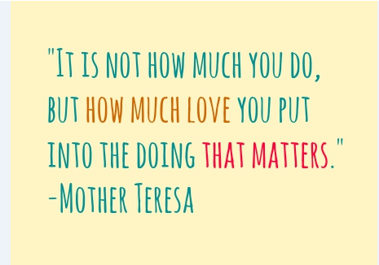

Slide 15
Thank you very much !

Slide 16
Session two
Elements of compassionate care

Slide 17
Introduction
Notes:
Chemistry. one of a class of substances that cannot be separated into simpler substances by chemical means. See also chart under periodictable.

Slide 18
Introduction
a component or constituent of a whole or one of the parts into which a whole may be resolved by analysis:

Slide 19
Session Objective
At the end of this session participants will be able to:
Identify elements of compassionate care
Explain elements of compassionate care

Slide 20
Elements of compassionate care
According to research, the key elements of compassionate care have seven elements, each contains themes and sub-themes.

Slide 21
Elements of Compassionate Care
Virtue
Relational space
Virtuous Response
Seeking to Understand
Relational Communicating
Attending to Needs
Patient-Reported Outcomes

Slide 22
Virtue
good or noble qualities embodied in the character of the health care provider.
genuineness,
love,
honesty,
openness,
care
authenticity,
Understanding
tolerance,
kindness, and
acceptance.

Slide 23
Relational space
Is a compassionate encounter where the person suffering is aware of and is engaged by, the virtues of the health care provider.
The category of relational space comprised two themes.

Slide 24
Cont…..
Patient awareness : patients intuitively knew or initially sensed health care provider capacity for compassion.
Engaged care giving: refers to tangible indicators of health care provider compassion and provider-patient relationship over time.

Slide 25
Virtuous Response
Is defined as the enactment of a virtue toward a person in suffering
Virtuous response contained three broad themes within it:

Slide 26
Cont….
Knowing the person: is approaching their patients as persons and viewed their health issues and suffering from this vantage point.
Person as priority: ability to prioritize patient needs
Beneficence: refers to health care providers desiring the best for the patient

Slide 27
Seeking to Understand
The extent providers attempt to understand the patient as a person and their unique needs to optimize the effect of compassion.
Seeking to understand contained two themes within it:
Seeking to Understand the Person.
Seeking to Understand the Person’s Needs.
Notes:
Seeking to understand extended health care providers’ initial desire to know and prioritize the patient as a person by pursuing a deeper understanding of the person and their unique illness experience to understand the person behind the disease.

Slide 28
Understanding game

Slide 29
Relational Communicating
It is mediated through verbal and nonverbal communication conveyed through health care provider and the person in suffering.
Relational communicating contain four themes:
Demeanour: is way of nonverbal communication such as body language as initial indicators of compassion- based communication.
Notes:
Demeanor was closely related to the theme of ‘‘patient awareness’’ within the category of ‘‘relational space’’ but differed in being more sensory- based, developed, and contextual to clinical communication in comparison with the extrasensory character of patient awareness.

Slide 30
Cont…..
Affect: Providers actively resonate with their patients’ emotions and the influence that their virtues in this process.
Behaviors: refers to physical displays of caring, and listening and supportive words.
Engagement: the degree to which patients feel that health care providers are actively present in the clinical encounter.

Slide 31
Role Play on Rational Communication
Selected for teach-back sessions in the ToT training

Slide 32
Attending to Needs
Is a timely and receptive desire to actively engage in and address a person’s multi-factorial suffering.
Attending to needs had three interrelated themes:
Compassion-Related Needs: providers willingness to attend to a patient’s immediate needs.

Slide 33
Cont….
Timely: addressing suffering in a ‘‘timely’’ manner.
Action: refer to the initiation and engagement of a dynamic and tangible process aimed at alleviating suffering.

Slide 34
Case Study on Attending to needs
Discuss the case in your small group and answer the follow up questions
Time Allowed 30 Minutes

Slide 35
Patient-Reported Outcomes
The effect of compassion on suffering, patient well-being, and care.
In research, although some patients felt that compassion directly improved health outcomes, most felt it primarily enhanced their wellbeing and the quality of their relationship with their health care providers.

Slide 36
Session three
Principles of compassionate care

Slide 37
Brain storming on principles of compassionate care
What are the principles of compassionate care?

Slide 38
Session Objective
At the end of this session, participants will be able to:
List principles of compassionate care
Discuss principles of compassionate care
Apply principles of compassionate care

Slide 39
Principles of compassionate care
Attention :is the principle of where you put your focus – your undivided attention breaths life into whatever you focus on. It is the quality of your awareness that picks up the signals of what really matters.

Slide 40
Cont…
Acknowledgement : is what you give voice to, we affirm – your faithful report of what you have witnessed – to literally confess the knowledge you gained by paying attention.

Slide 41
Cont…
Affection: is how healthcare providers affect or touch people.
Human contact has the ability to touch someone’s life.
It is the quality of your connection, mainly through warmth, comfort, kindness and humor.

Slide 42
Cont.
Acceptance: Is being at peace with the way things are allows them to change– how you stand at the edge of your understanding or at the beginning of a new experience, and regard what is beyond with equanimity..

Slide 43
Role play on Principles of Compassionate care
By the end participants will be able to:-
Demonstrate principles of compassionate care

Slide 44
Cont…
Follow the role play using your participant manual and respond to the discussion questions following the role play.

Slide 45
Cont.
Discussion Questions
Did the health provider follow the principles compassionate care?
If not, what are the areas /conversation that show inadequate application of principles?
How would you practice principles of compassionate care if you were in the same scenario?

Slide 46
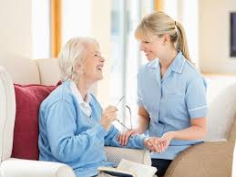
Summary
Acknowledgement
Affection
Attention
Acceptance

Slide 47
Thank you very much !!

Slide 48
Session four
Threats of Compassion
Notes:
Compassion can be a difficult choice to make - after all, why would we deliberately choose to add another person's pain to our own? "Not only does our compassion ease the suffering of others," teaches Dr. McGonigal, "Our brain, heart, and entire physiology are tuned to support us when we make the courageous decision to be compassionate." In this seven-hour training intensive, she provides invaluable tools and guidance for overcoming emotional fatigue, empathic distress, self-judgment, and other obstacles that can keep us closed down and afraid to reach out. "Compassion is an embodied state that prepares us to take positive action," says Dr. McGonigal.

Slide 49
Introduction
Factors affecting compassionate care

Slide 50
Factors affecting Compassion
Factors which prevent compassion and compassionate behavior :
Compassionate fatigue
Unbalanced focus in biomedical model in clinical training
Stress depression and burnout
The wider hospital context

Slide 51
Unbalanced focus in biomedical model in clinical training
Training of health professionals gives emphasis to biomedical model.
focuses on disease in scientific, pathological and physiological terms,
Medicine has evolved more as a science than as a "mystical art".
Notes:
“In the sick room, ten cents' worth of human understanding equals ten dollars' worth of medical science.” Martin H. Fischer

Slide 52
2. The wider hospital context
Financial balance (mostly in private facilities)
Meeting national targets (public facilities)
Deeply affects the priorities and behaviors of staff throughout the hospital.

Slide 53

3. Compassion Fatigue
What is compassion fatigue?
Compassion – Emotional Fatigue – Exhaustion
~ A form of emotional exhaustion that occurs after repeated exposure to the suffering of others while in a caring role.

Slide 54
Why are some health care providers more vulnerable to compassion fatigue ?
Personal Characteristics
Task Characteristics
Perfectionists and Over-Achievers
Competent
Compassionate
Committed
Significant Needs
Limited Resources
Time pressure and Deadlines
Difficulties are common

Slide 55
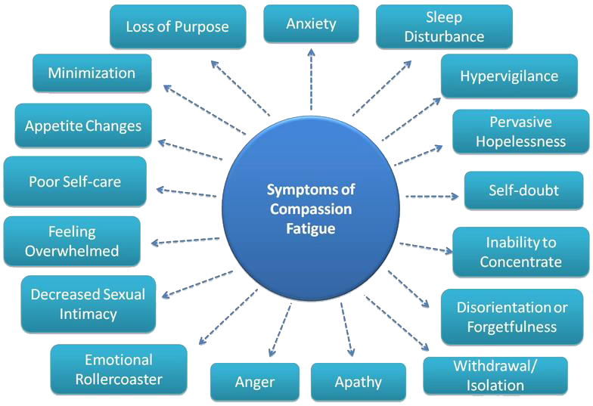
How do you know if you have compassion fatigue?

Slide 56
Organizational symptoms of Compassion Fatigue
High absenteeism
Constant changes in co-workers relationships
Inability for teams to work well together
Desire among staff members to break company rules
Outbreaks of aggressive behaviors among staff
Inability of staff to complete assignments and tasks
Inability of staff to respect and meet deadlines
Lack of flexibility among staff members
Negativism towards management
Strong reluctance toward change
Inability of staff to believe improvement is possible
Lack of a vision for the future

Slide 57

4.
4.
Burnout has to do with what we do, how we do it, and for how long we do it. It is usually brought on by unreasonable work expectations, (of yourself or from others) or environmental work related stress. It has more to do with systems, processes and organizations. It also has to do with lack of self care and poor boundary setting.

Slide 58
How is Compassion fatigue different from Burn out?
“ Burnout is a process that involves
a) gradual repeated exposure to job strains;
b) erosion of idealism and
c) a lack of a sense of achievement.” Gentry (2007)
“Burnout occurs when there is a chronic condition of perceived demands that outweigh perceived resources.” Baranowsky (2010).
Untreated Compassion Fatigue can lead to burn out.

Slide 59
Small Group Exercise # 1
Discuss a case that caused you some symptoms of compassion fatigue?
Identify what factors caused you to identify with the person/victim/family/event
Note commonalities and choose a person to share these findings with the larger group

Slide 60

Systemic Prevention is possible - Organizational policies and procedures can be evaluated and adapted to enhance the resiliency of employees and staff.
Primarily individual responsibility rests with each individual to manage themselves (and their stresses) both in and out of the workplace!!
SELF CARE is the KEY!!

Slide 61
Self-Care is multi-dimensional!!
Physical Strategies
Psychological Strategies
Emotional Strategies
Spiritual Self-care
Work strategies

Slide 62

Self-Awareness Exercise
Compassion Fatigue Test
Life Balance scale

Slide 63

Do a little self assessment!
Life Balance Wheel
Here is a tool you can use to assess the level of your satisfaction with all of the aspects of your life.
Place each aspect of your life in the space in each segment. Some suggestions follow. Modify these to represent those that are meaningful to you.
Self Care
Work
Intimate Partner/Family
Friends/Social Life
Financial Aspects
Health & Wellness/Body Image
Spiritual Aspects
Community/Service
Now rate your satisfaction with each aspect, using a scale from zero to ten, with ten being very satisfied and zero being completely unsatisfied. Place a mark indicating your choice in each segment of the circle, with zero at the center and ten at the rim. Connect all of the marks around the circle to see how balanced your wheel is.

Slide 64
Balance Keeping Your Life in Balance
Nurture yourself by putting activities in your schedule that are sources of pleasure, joy and diversion
Allow yourself to take mini-escapes- these relieve the intensity of your work
Transform the negative impact of your work (find meaning, challenge negativity, find gratitude)

Slide 65

"We can be sure that the greatest hope for maintaining equilibrium in the face of any situation rests within ourselves."
Francis J. Braceland

Slide 66

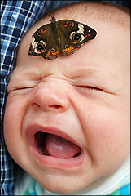
Balance for our Emotional Needs
Emotions are a signal that tell us when something is wrong or we are out of balance
We all need meaning and purpose in our life

Slide 67
Find Hidden Passion
We all have hidden sources of energy and healing power.
When you identify the things that fuel you, the things that you have true passion for, your fatigue will disappear.
Balancing your life involves putting the things that we value and have passion for in our schedule.

Slide 68

What do you need to succeed? Make your plan! Find the resources.

Slide 69
Balance for Your Soul
Have quiet alone time in a calm, beautiful place- a safe retreat where you feel renewed
Have an awareness of what restores and replenishes you.
Stay clear with commitment to career goals or your personal mission
Know how to focus on what you can control
Look at situations as entertaining challenges and opportunities, not problems or stresses

Slide 70

Keep Yourself Physically Strong
Exercise
Relax-Breathe
Get adequate sleep
Good nutrition and water
Good medical and preventative care

Slide 71
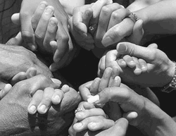
Connections
Talk out your stress- process your thoughts and reactions with someone else (coworker, therapist, clergy, friend, family, supervisor)
Build a positive support system that supports you, not fuels your stress

Slide 72
Put Joy, Love, Hope, Laughter and Gratitude in Each Day
Name 3 things you feel grateful for today-
Think of something that has brought you a sense of joy (Make your top ten list)
Who do you love that you can reach out to today? (Call them!)
What made you laugh today? (Share it!)

Slide 73
Some Final Thoughts
Compassion Fatigue is always a possibility for those who care for others.
If you don’t care for yourself, physically, emotionally and spiritually, then eventually there will not be enough of you left to care for anyone else.

Slide 74
“I would rather do mistakes in kindness than do miracles in unkindness and hardness”. Mother Theresa

Slide 75
Thank you!

Slide 76
Session five
Guided clinical practice

Slide 77
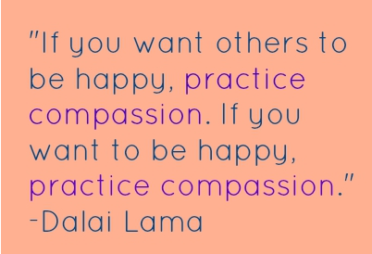
Introduction

Slide 78
Session Objective
By the end of this session the participants will be able to:
Evaluate the status of compassionate care practice at health facilities
Reflect on the assessment findings their observation on the compassionate care practice at health facilities

Slide 79
Activity
Divide in to three group based on the wards to be observed (Emergency, inpatient & outpatient)
Observe the wards for 4 hr using checklist
Do not give feedback to the health care providers observed or to the institution.

Slide 80
Activity
Following observation analyze the data you have collected and reflect your finding using the reflection format
Each group will have 15 minute to reflect their finding

Slide 81
Thank you very much !

